Slide 1
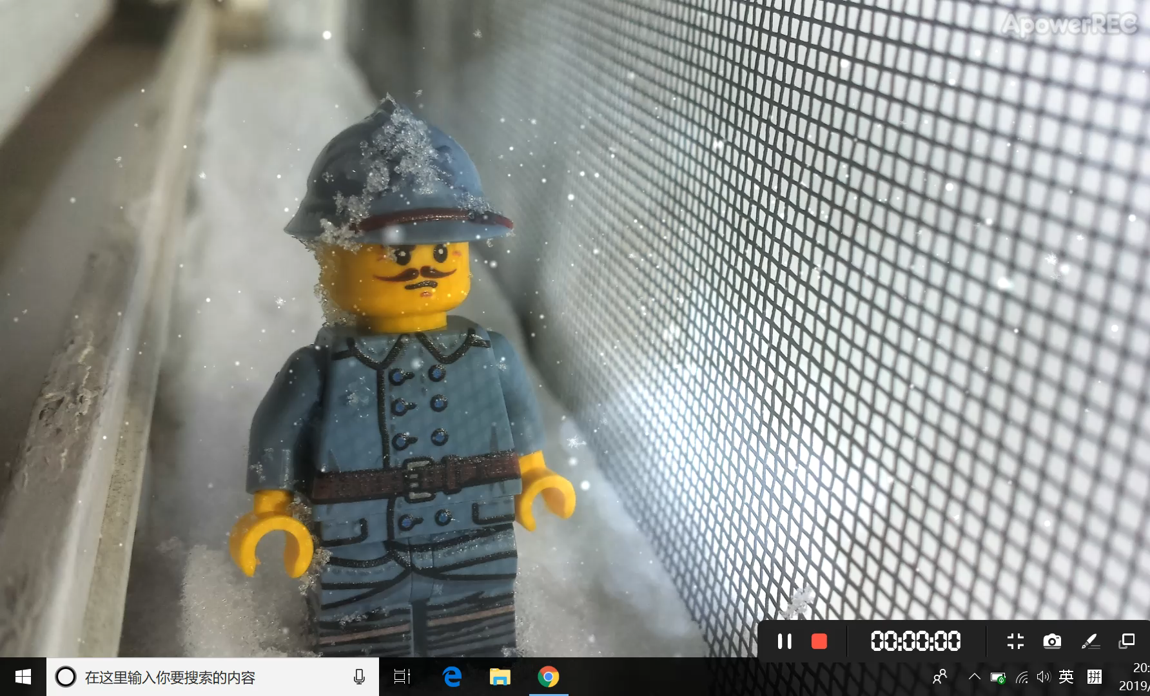
LEGO Sets Exploration
Jingyi LI

Slide 2

INTRODUCTION
Purpose
Call back the LEGO memory, study the sets features and build a sets recommendation system for LEGO fans.
Data preparation
BUILD
Sets evolution
THE
Pricing strategy of sets
BRICK
Recommendation system

Slide 3

Data preparation
Original datasets from Rebrickable
Crawled data from Bricksets with Python Scrapy
Used 9 datasets in total

Slide 4
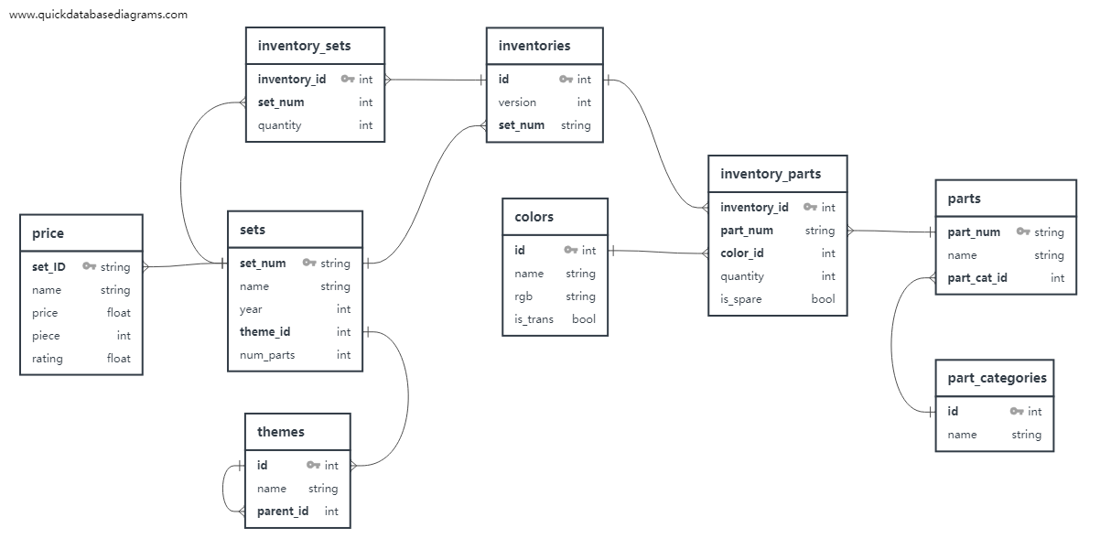
DATA MODELING

Slide 5
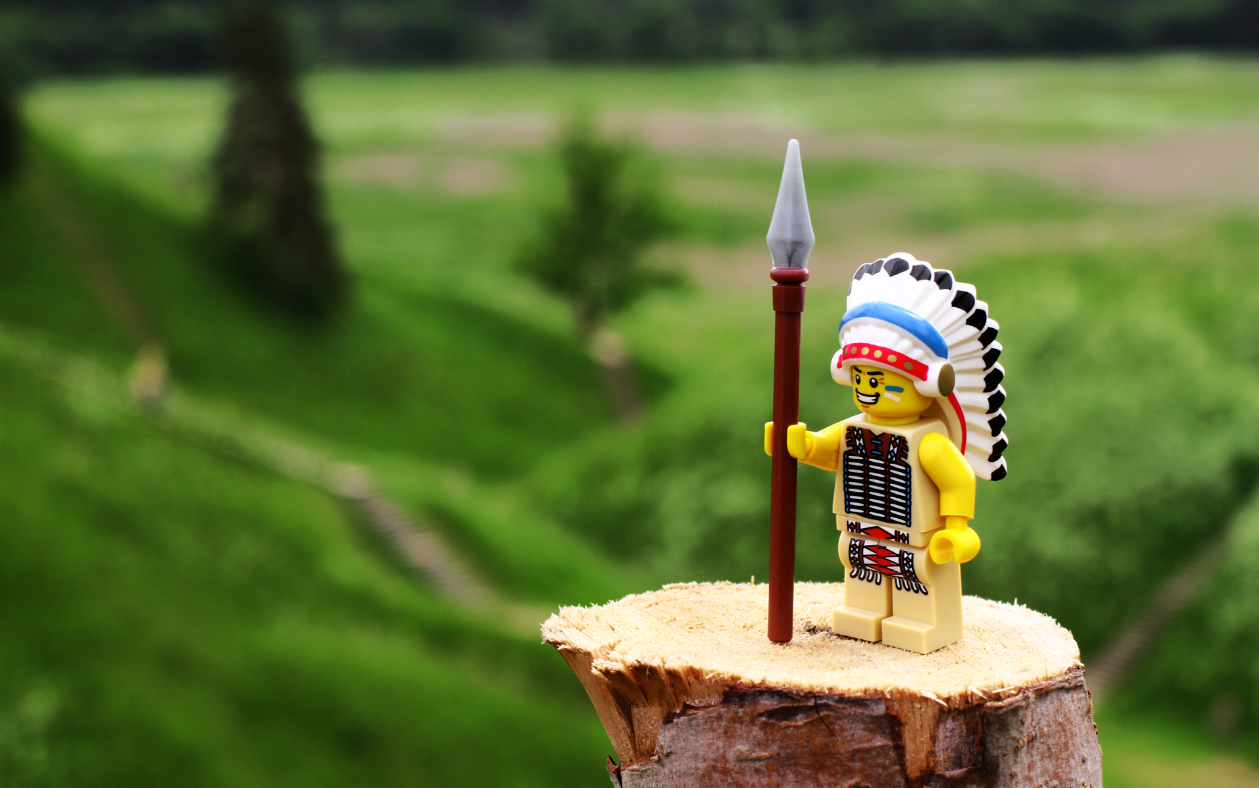
Sets evolution
Historical evolution of LEGO sets can be a quite interesting topic for fans who have grown up with LEGO and still play with bricks

Slide 6
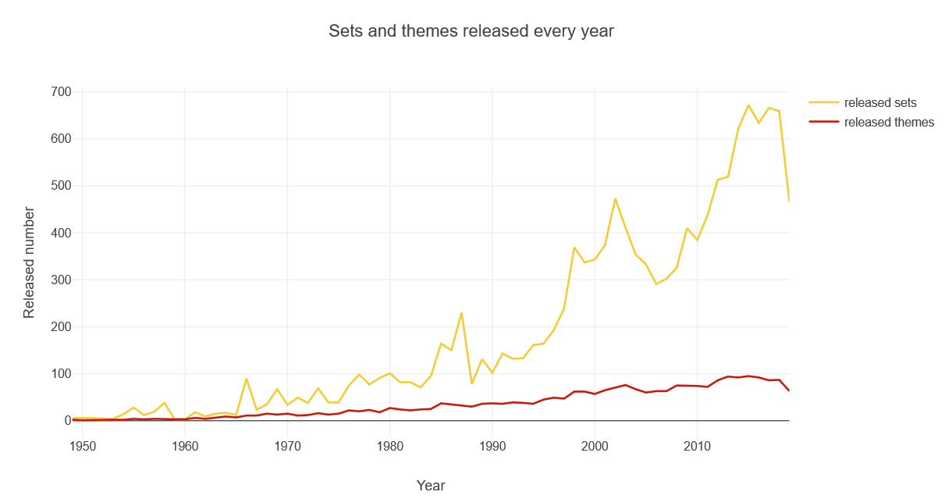

Sets and themes released by year
Number of sets in each theme is increasing rapidly

Slide 7
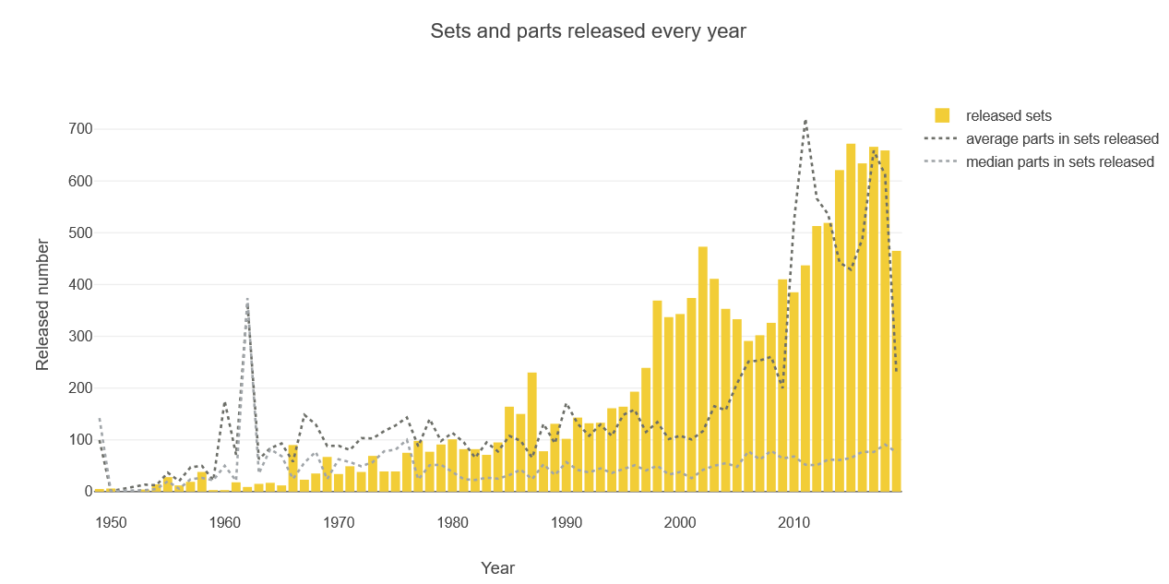
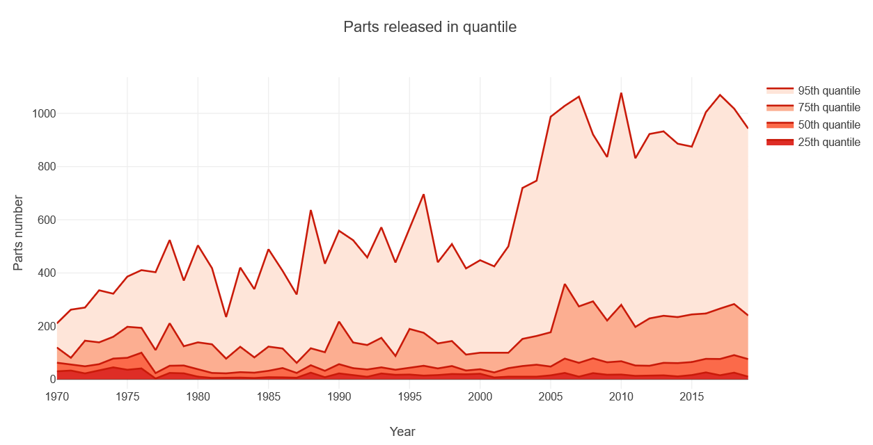
Average parts change in sets
Average parts number in a set increases dramatically, but the median remains stable.
Variety of parts increases in these years.
Extremely large sets in 95th quantile mainly drives the growth.
Large sets grow larger and small sets remain unchanged.

Slide 8
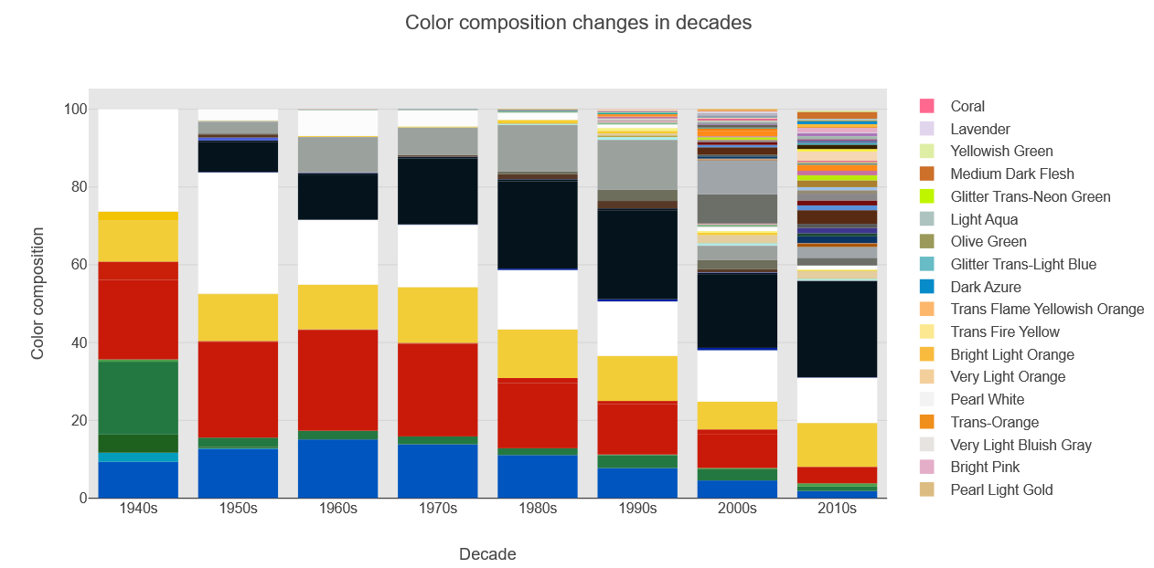
Color composition by year
Classical LEGO colors still play a key role
With the development of new themes and changes in customer preferences, LEGO is becoming more and more colorful.

Slide 9
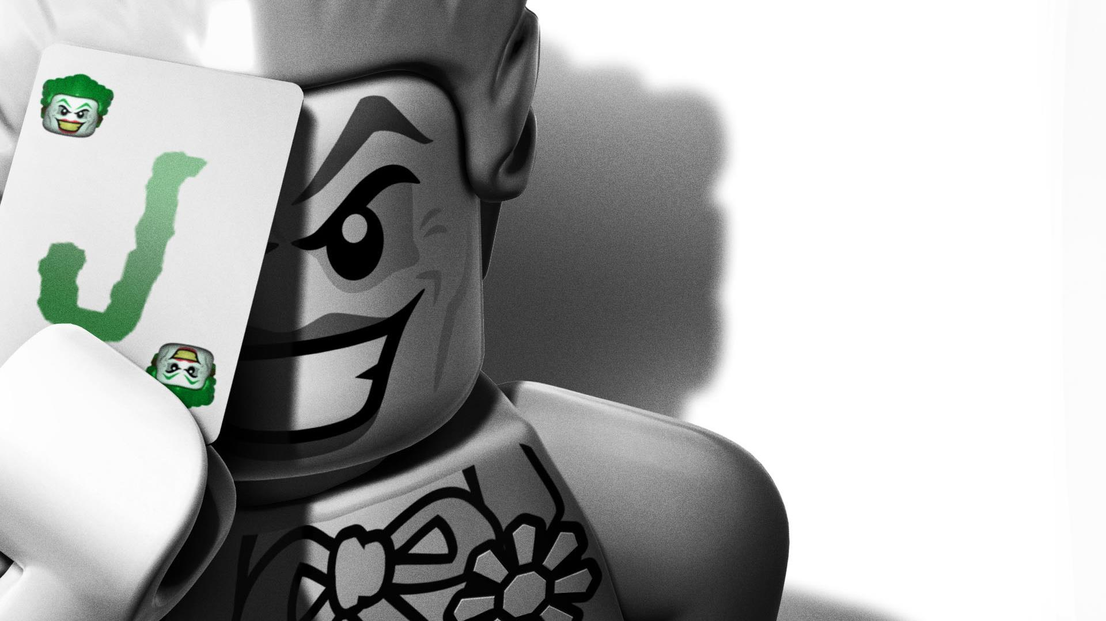
Pricing
Strategy
People think that LEGO price is getting incredibly high?

Slide 10
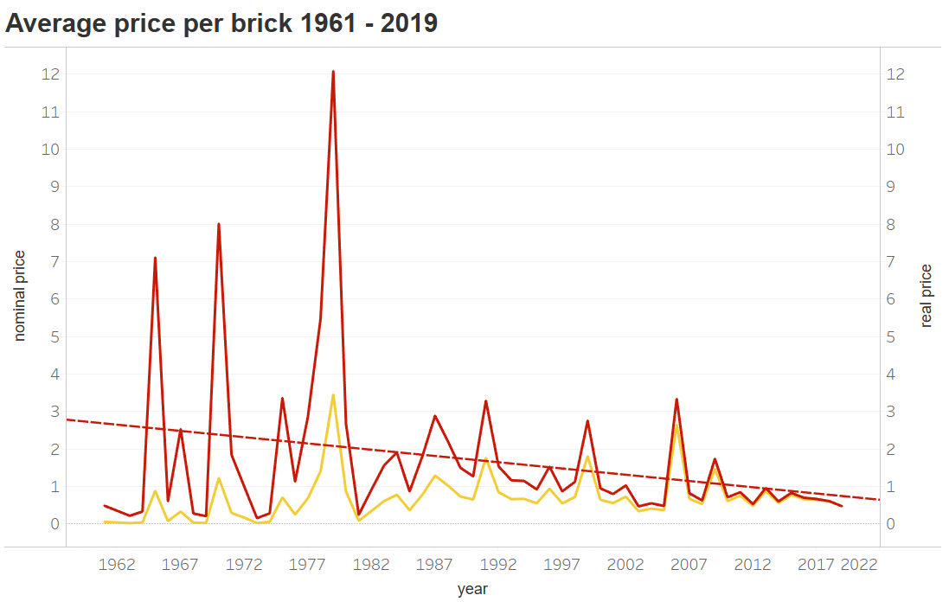
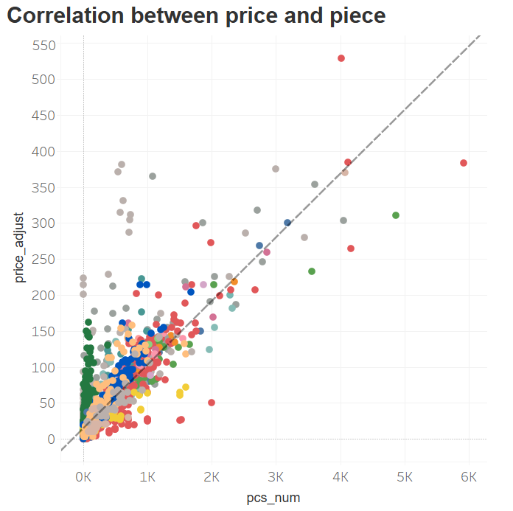


Pricing Strategy
Mindstorm
Duplo
Against stereotypes LEGO price is decreasing
Price and Bricks show correlation
Different pricing strategy in special themes

Slide 11
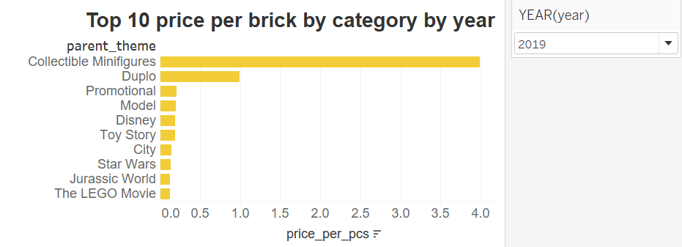

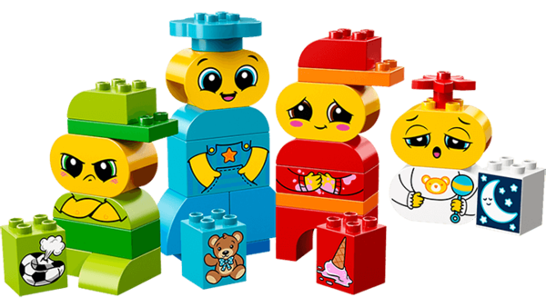
Pricing Strategy
Duplo bricks are designed for children (< 5).
Its large and smoother without pointed edges.
Minifigures are special bricks represents people and it has more complex structure than normal bricks.

Slide 12
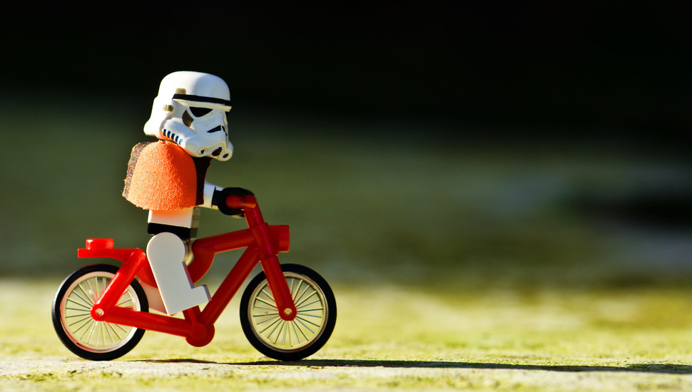
Recommendation
Based on the sets a user have already owned, recommend the sets he can build from current bricks.
Enjoy the experience of recreation and build sets with limited edition.

Slide 13
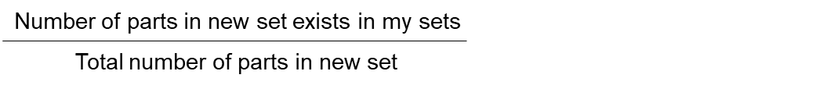
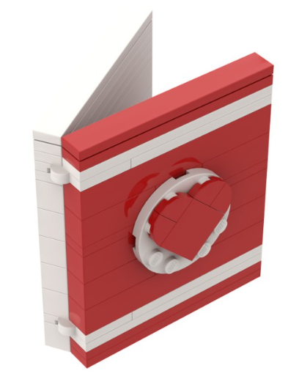
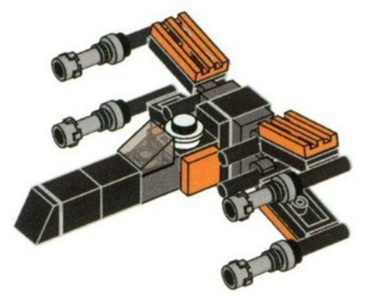
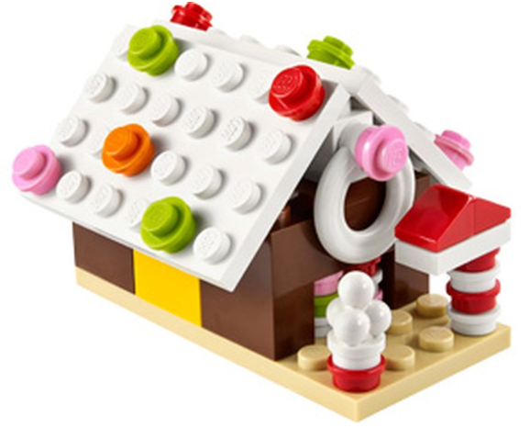
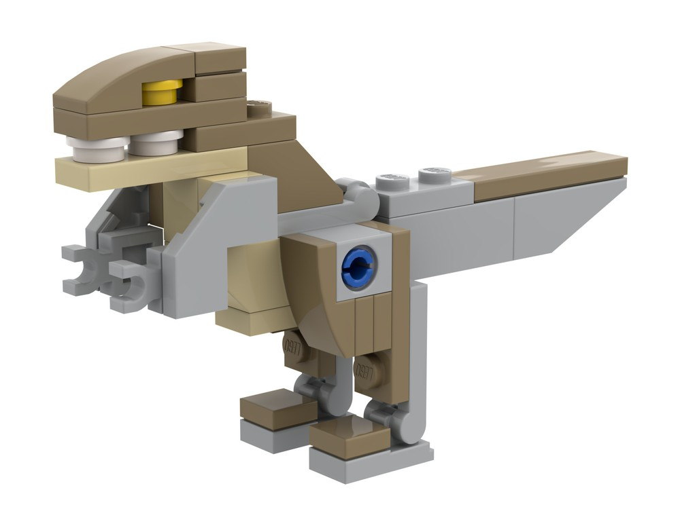
Example
Each set has a vector represents which parts contained in it
Gather all parts in my sets
Calculate a completion score:
Current sets in hand
porsche 911 (42056-1)
detective's office (10246-1)
mickey mouse (41624-1)
minnie mouse (41625-1)
beatles yellow submarine (21306-1)
downtown dinner (10260-1)
thanos (41605-1)
iron man (41604-1)
steamboat willie (21317-1)
What I can build from these sets?
93 new sets
A Valentine’s Day card
A Gingerbread House
A X-wing fighter
A Dinosaur

Slide 14

Thank you

